Slide 1
Predicting The Value of a College Basketball Player in the NBA
BY:
Seth Ranasinghe

Slide 2
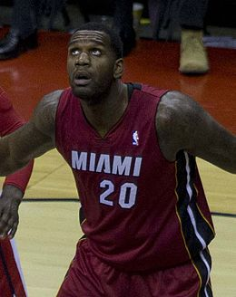
Problem
Optimizing draft pick is crucial for any NBA team
Rookie performance is highly variable
Poor decisions can lead to huge waste in time and resources for NBA franchise

Slide 3
Objective
Create a linear regression model that will predict the value a player will bring to the NBA
For our model, we will be assuming that PER is the metric for “value”
Use college statistics to project what PER a player would bring
2PM, 3PM, FGMiss, FTM, FTMiss, ORB, DRB, Assists, TO, Steals, and Fouls
Optimize model by balancing bias and variance

Slide 4
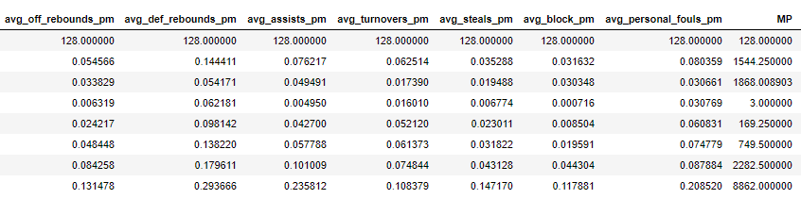
Exploratory Data Analysis
NCAA dataset: BigQuery dataset from Kaggle pulled using SQL – 11000 rows of all NCAA players from 2011-2017
NBA dataset: CSV export from Kaggle of player stats from 1950
Total amount of data after join: 128 rows before cleaning, 97 after

Slide 5
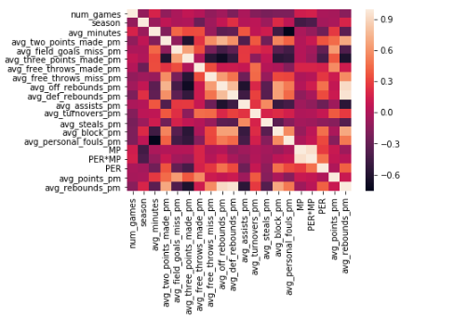
Exploratory Data Analysis (Continued)
Based on the correlation heatmap, when comparing to PER, some independent variables act different from anticipated
Additional variables created to combine some of the stats given to reflect more standard basketball statistics

Slide 6
Modeling Process
Tested Train-Test-Split and Kfold with linear regression, as well as Random Forest Regressor models for fitting the data
Varied parameters and graphed results to optimize
Compared optimized models to each other to determine ideal model to use

Slide 7
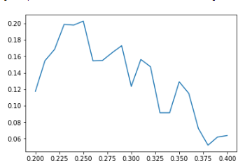
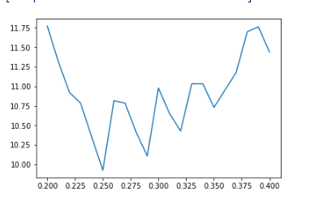
Linear Regression Test-Train-Split
R2 Optimization
MSE Optimization

Slide 8
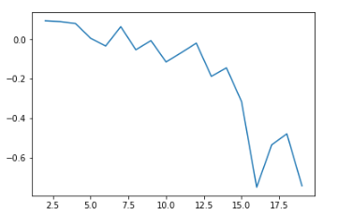
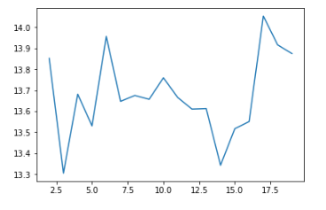
Linear Regression K Fold
R2 Optimization
MSE Optimization

Slide 9
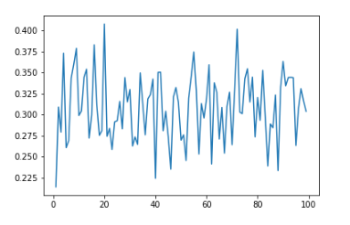
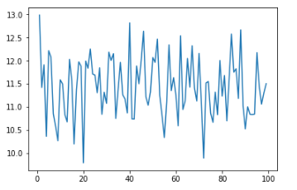
Random Forest
R2 Optimization
MSE Optimization

Slide 10
Conclusion
Based on the models tested, the most optimal for predicting PER is the random forest model (MSE = 11 and R² = .33)
However, base on this analysis there is a lot of error that is unexplained in any of these models, which can potentially be explained by variables outside the scope of this study

Slide 11
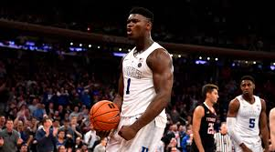
Next steps
Incorporate variables that are not just specific to players game statistics, but also to their physical capabilities (ex. Height, weight, NBA combine stats)
Create an API that will update current NCAA players stats and adjust predicted draft order based on performance metric where someone can input a name of a player in college and get their relative performance back
Incorporate international players

